Slide 1
Introduction to Hidden Markov Models

Slide 2
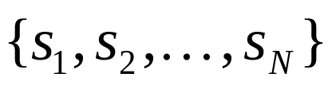
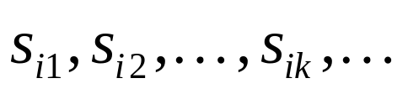
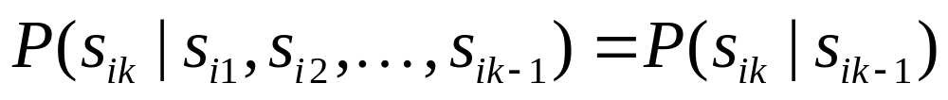
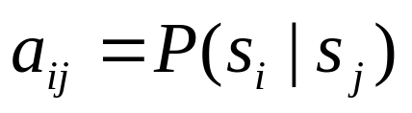
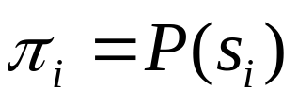
Markov Models
Set of states:
Process moves from one state to another generating a sequence of states :
Markov chain property: probability of each subsequent state depends only on what was the previous state:
To define Markov model, the following probabilities have to be specified: transition probabilities and initial probabilities

Slide 3
Example of Markov Model
0.3
0.7
Rain
Dry
0.2
0.8
Two states : ‘Rain’ and ‘Dry’.
Transition probabilities: P(‘Rain’|‘Rain’)=0.3 , P(‘Dry’|‘Rain’)=0.7 , P(‘Rain’|‘Dry’)=0.2, P(‘Dry’|‘Dry’)=0.8
Initial probabilities: say P(‘Rain’)=0.4 , P(‘Dry’)=0.6 .

Slide 4
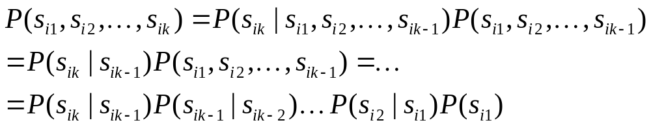
Calculation of sequence probability
By Markov chain property, probability of state sequence can be found by the formula:
Suppose we want to calculate a probability of a sequence of states in our example, {‘Dry’,’Dry’,’Rain’,Rain’}.
P({‘Dry’,’Dry’,’Rain’,Rain’} ) =
P(‘Rain’|’Rain’) P(‘Rain’|’Dry’) P(‘Dry’|’Dry’) P(‘Dry’)=
= 0.3*0.2*0.8*0.6

Slide 5
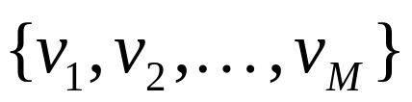
Hidden Markov models.
Set of states:
Process moves from one state to another generating a sequence of states :
Markov chain property: probability of each subsequent state depends only on what was the previous state:
States are not visible, but each state randomly generates one of M observations (or visible states)
To define hidden Markov model, the following probabilities have to be specified: matrix of transition probabilities A=(a_{ij}), a_{ij}= P(s_{i} | s_{j}) , matrix of observation probabilities B=(b_{i} (v_{m} )), b_{i}(v_{m} ) = P(v_{m} | s_{i}) and a vector of initial probabilities π=(π_{i}), π_{i} = P(s_{i}) . Model is represented by M=(A, B, π).

Slide 6
Example of Hidden Markov Model
0.3
0.7
Low
High
0.2
0.8
0.6
0.6
0.4
0.4
Rain
Dry

Slide 7
Example of Hidden Markov Model
Two states : ‘Low’ and ‘High’ atmospheric pressure.
Two observations : ‘Rain’ and ‘Dry’.
Transition probabilities: P(‘Low’|‘Low’)=0.3 , P(‘High’|‘Low’)=0.7 , P(‘Low’|‘High’)=0.2, P(‘High’|‘High’)=0.8
Observation probabilities : P(‘Rain’|‘Low’)=0.6 , P(‘Dry’|‘Low’)=0.4 , P(‘Rain’|‘High’)=0.4 , P(‘Dry’|‘High’)=0.3 .
Initial probabilities: say P(‘Low’)=0.4 , P(‘High’)=0.6 .

Slide 8
Calculation of observation sequence probability
Suppose we want to calculate a probability of a sequence of observations in our example, {‘Dry’,’Rain’}.
Consider all possible hidden state sequences:
P({‘Dry’,’Rain’} ) = P({‘Dry’,’Rain’} , {‘Low’,’Low’}) + P({‘Dry’,’Rain’} , {‘Low’,’High’}) + P({‘Dry’,’Rain’} , {‘High’,’Low’}) + P({‘Dry’,’Rain’} , {‘High’,’High’})
where first term is :
P({‘Dry’,’Rain’} , {‘Low’,’Low’})=
P({‘Dry’,’Rain’} | {‘Low’,’Low’}) P({‘Low’,’Low’}) =
P(‘Dry’|’Low’)P(‘Rain’|’Low’) P(‘Low’)P(‘Low’|’Low)
= 0.4*0.4*0.6*0.4*0.3

Slide 9
Main issues using HMMs :
Evaluation problem. Given the HMM M=(A, B, π) and the observation sequence O=o₁ o₂ ... o_{K} , calculate the probability that model M has generated sequence O .
Decoding problem. Given the HMM M=(A, B, π) and the observation sequence O=o₁ o₂ ... o_{K} , calculate the most likely sequence of hidden states s_{i} that produced this observation sequence O.
Learning problem. Given some training observation sequences O=o₁ o₂ ... o_{K} and general structure of HMM (numbers of hidden and visible states), determine HMM parameters M=(A, B, π) that best fit training data.
O=o₁...o_{K} denotes a sequence of observations o_{k}∈{v₁,…,v_{M}}.

Slide 10
Word recognition example(1).
Typed word recognition, assume all characters are separated.
Amherst
Character recognizer outputs probability of the image being particular character, P(image|character).
a
0.5
b
0.03
c
A
0.005
z
0.31
Hidden state Observation

Slide 11

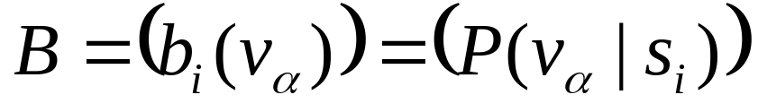
Word recognition example(2).
Hidden states of HMM = characters.
Observations = typed images of characters segmented from the image . Note that there is an infinite number of observations
Observation probabilities = character recognizer scores.
Transition probabilities will be defined differently in two subsequent models.

Slide 12
Word recognition example(3).
If lexicon is given, we can construct separate HMM models for each lexicon word.
Amherst
a
m
h
e
r
s
t
Buffalo
b
u
f
f
a
l
o
0.5
0.03
0.4
0.6
A
m
Here recognition of word image is equivalent to the problem of evaluating few HMM models.
This is an application of Evaluation problem.

Slide 13
Word recognition example(4).
We can construct a single HMM for all words.
Hidden states = all characters in the alphabet.
Transition probabilities and initial probabilities are calculated from language model.
Observations and observation probabilities are as before.
a
m
r
f
t
o
b
h
v
e
s
Here we have to determine the best sequence of hidden states, the one that most likely produced word image.
This is an application of Decoding problem.

Slide 14
Character recognition with HMM example.
The structure of hidden states is chosen.
Observations are feature vectors extracted from vertical slices.
A
Probabilistic mapping from hidden state to feature vectors: 1. use mixture of Gaussian models
2. Quantize feature vector space.

Slide 15
Exercise: character recognition with HMM(1)
The structure of hidden states:
s₁
s₂
s₃
Observation = number of islands in the vertical slice.
HMM for character ‘A’ :
Transition probabilities: {a_{ij}}=
Observation probabilities: {b_{jk}}=
⎛ .8 .2 0 ⎞
⏐ 0 .8 .2 ⏐
⎝ 0 0 1 ⎠
A
⎛ .9 .1 0 ⎞
⏐ .1 .8 .1 ⏐
⎝ .9 .1 0 ⎠
HMM for character ‘B’ :
Transition probabilities: {a_{ij}}=
Observation probabilities: {b_{jk}}=
⎛ .8 .2 0 ⎞
⏐ 0 .8 .2 ⏐
⎝ 0 0 1 ⎠
B
⎛ .9 .1 0 ⎞
⏐ 0 .2 .8 ⏐
⎝ .6 .4 0 ⎠

Slide 16
Exercise: character recognition with HMM(2)
Suppose that after character image segmentation the following sequence of island numbers in 4 slices was observed:
{ 1, 3, 2, 1}
What HMM is more likely to generate this observation sequence , HMM for ‘A’ or HMM for ‘B’ ?

Slide 17
Exercise: character recognition with HMM(3)
Consider likelihood of generating given observation for each possible sequence of hidden states:
HMM for character ‘A’:
Hidden state sequence
Transition probabilities
Observation probabilities
s₁→ s₁→ s₂→s₃
.8 ∗ .2 ∗ .2 ∗ .9 ∗ 0 ∗ .8 ∗ .9 = 0
s₁→ s₂→ s₂→s₃
.2 ∗ .8 ∗ .2 ∗ .9 ∗ .1 ∗ .8 ∗ .9 = 0.0020736
s₁→ s₂→ s₃→s₃
.2 ∗ .2 ∗ 1 ∗ .9 ∗ .1 ∗ .1 ∗ .9 = 0.000324
Total = 0.0023976
HMM for character ‘B’:
Hidden state sequence
Transition probabilities
Observation probabilities
s₁→ s₁→ s₂→s₃
.8 ∗ .2 ∗ .2 ∗ .9 ∗ 0 ∗ .2 ∗ .6 = 0
s₁→ s₂→ s₂→s₃
.2 ∗ .8 ∗ .2 ∗ .9 ∗ .8 ∗ .2 ∗ .6 = 0.0027648
s₁→ s₂→ s₃→s₃
.2 ∗ .2 ∗ 1 ∗ .9 ∗ .8 ∗ .4 ∗ .6 = 0.006912
Total = 0.0096768

Slide 18
Evaluation Problem.
Evaluation problem. Given the HMM M=(A, B, π) and the observation sequence O=o₁ o₂ ... o_{K} , calculate the probability that model M has generated sequence O .
Trying to find probability of observations O=o₁ o₂ ... o_{K} by means of considering all hidden state sequences (as was done in example) is impractical:
N^{K} hidden state sequences - exponential complexity.
Use Forward-Backward HMM algorithms for efficient calculations.
Define the forward variable α_{k}(i) as the joint probability of the partial observation sequence o₁ o₂ ... o_{k} and that the hidden state at time k is s_{i} : α_{k}(i)= P(o₁ o₂ ... o_{k ,} q_{k}= s_{i} )

Slide 19
Trellis representation of an HMM
o₁ o_{k} o_{k+1} o_{K} = Observations
s₁
s₁
s₁
s₁
s₂
s₂
a_{1j}
s₂
s₂
a_{2j}
s_{i}
s_{i}
s_{j}
s_{i}
a_{ij}
a_{Nj}
s_{N}
s_{N}
s_{N}
s_{N}
Time= 1 k k+1 K

Slide 20
Forward recursion for HMM
Initialization:
α₁(i)= P(o_{1 ,} q₁= s_{i} ) = π_{i} b_{i} (o₁) , 1<=i<=N.
Forward recursion:
α_{k+1}(i)= P(o₁ o₂ ... o_{k+1 ,} q_{k+1}= s_{j} ) =
Σ_{i} P(o₁ o₂ ... o_{k+1 ,} q_{k}= s_{i ,} q_{k+1}= s_{j} ) =
Σ_{i} P(o₁ o₂ ... o_{k ,} q_{k}= s_{i}) a_{ij} b_{j} (o_{k+1} ) =
[Σ_{i} α_{k}(i) a_{ij} ] b_{j} (o_{k+1} ) , 1<=j<=N, 1<=k<=K-1.
Termination:
P(o₁ o₂ ... o_{K}) = Σ_{i} P(o₁ o₂ ... o_{K ,} q_{K}= s_{i}) = Σ_{i} α_{K}(i)
Complexity :
N²K operations.

Slide 21
Backward recursion for HMM
Define the forward variable β_{k}(i) as the joint probability of the partial observation sequence o_{k+1} o_{k+2} ... o_{K} given that the hidden state at time k is s_{i} : β_{k}(i)= P(o_{k+1} o_{k+2} ... o_{K} |q_{k}= s_{i} )
Initialization:
β_{K}(i)= 1 , 1<=i<=N.
Backward recursion:
β_{k}(j)= P(o_{k+1} o_{k+2} ... o_{K} | q_{k}= s_{j} ) =
Σ_{i} P(o_{k+1} o_{k+2} ... o_{K ,} q_{k+1}= s_{i} | q_{k}= s_{j} ) =
Σ_{i} P(o_{k+2} o_{k+3} ... o_{K} | q_{k+1}= s_{i}) a_{ji} b_{i} (o_{k+1} ) =
Σ_{i} β_{k+1}(i) a_{ji} b_{i} (o_{k+1} ) , 1<=j<=N, 1<=k<=K-1.
Termination:
P(o₁ o₂ ... o_{K}) = Σ_{i} P(o₁ o₂ ... o_{K ,} q₁= s_{i}) =
Σ_{i} P(o₁ o₂ ... o_{K} |q₁= s_{i}) P(q₁= s_{i}) = Σ_{i} β₁(i) b_{i} (o₁) π_{i}

Slide 22
Decoding problem
Decoding problem. Given the HMM M=(A, B, π) and the observation sequence O=o₁ o₂ ... o_{K} , calculate the most likely sequence of hidden states s_{i} that produced this observation sequence.
We want to find the state sequence Q= q₁…q_{K} which maximizes P(Q | o₁ o₂ ... o_{K} ) , or equivalently P(Q , o₁ o₂ ... o_{K} ) .
Brute force consideration of all paths takes exponential time. Use efficient Viterbi algorithm instead.
Define variable δ_{k}(i) as the maximum probability of producing observation sequence o₁ o₂ ... o_{k} when moving along any hidden state sequence q₁… q_{k-1} and getting into q_{k}= s_{i} .
δ_{k}(i) = max P(q₁… q_{k-1} , q_{k}= s_{i} , o₁ o₂ ... o_{k})
where max is taken over all possible paths q₁… q_{k-1} .

Slide 23
Viterbi algorithm (1)
General idea:
if best path ending in q_{k}= s_{j} goes through q_{k-1}= s_{i} then it should coincide with best path ending in q_{k-1}= s_{i} .
q_{k-1} q_{k}
s₁
a_{1j}
s_{i}
s_{j}
a_{ij}
s_{N}
a_{Nj}
δ_{k}(i) = max P(q₁… q_{k-1} , q_{k}= s_{j} , o₁ o₂ ... o_{k}) =
max_{i} [ a_{ij} b_{j} (o_{k} ) max P(q₁… q_{k-1}= s_{i} , o₁ o₂ ... o_{k-1}) ]
To backtrack best path keep info that predecessor of s_{j} was s_{i}.

Slide 24
Viterbi algorithm (2)
Initialization:
δ₁(i) = max P(q₁= s_{i} , o₁) = π_{i} b_{i} (o₁) , 1<=i<=N.
Forward recursion:
δ_{k}(j) = max P(q₁… q_{k-1} , q_{k}= s_{j} , o₁ o₂ ... o_{k}) =
max_{i} [ a_{ij} b_{j} (o_{k} ) max P(q₁… q_{k-1}= s_{i} , o₁ o₂ ... o_{k-1}) ] =
max_{i} [ a_{ij} b_{j} (o_{k} ) δ_{k-1}(i) ] , 1<=j<=N, 2<=k<=K.
Termination: choose best path ending at time K
max_{i} [ δ_{K}(i) ]
Backtrack best path.
This algorithm is similar to the forward recursion of evaluation problem, with Σ replaced by max and additional backtracking.

Slide 25
Learning problem (1)
Learning problem. Given some training observation sequences O=o₁ o₂ ... o_{K} and general structure of HMM (numbers of hidden and visible states), determine HMM parameters M=(A, B, π) that best fit training data, that is maximizes P(O | M) .
There is no algorithm producing optimal parameter values.
Use iterative expectation-maximization algorithm to find local maximum of P(O | M) - Baum-Welch algorithm.

Slide 26
Learning problem (2)
If training data has information about sequence of hidden states (as in word recognition example), then use maximum likelihood estimation of parameters:
a_{ij}= P(s_{i} | s_{j}) =
Number of transitions from state s_{j} to state s_{i}
Number of transitions out of state s_{j}
Number of times observation v_{m} occurs in state s_{i}
Number of times in state s_{i}
b_{i}(v_{m} ) = P(v_{m} | s_{i})=

Slide 27
Baum-Welch algorithm
General idea:
Expected number of transitions from state s_{j} to state s_{i}
Expected number of transitions out of state s_{j}
a_{ij}= P(s_{i} | s_{j}) =
Expected number of times observation v_{m} occurs in state s_{i}
Expected number of times in state s_{i}
b_{i}(v_{m} ) = P(v_{m} | s_{i})=
π_{i} = P(s_{i}) = Expected frequency in state s_{i} at time k=1.

Slide 28
Baum-Welch algorithm: expectation step(1)
Define variable ξ_{k}(i,j) as the probability of being in state s_{i} at time k and in state s_{j} at time k+1, given the observation sequence o₁ o₂ ... o_{K} .
ξ_{k}(i,j)= P(q_{k}= s_{i} , q_{k+1}= s_{j} | o₁ o₂ ... o_{K})
P(q_{k}= s_{i} , q_{k+1}= s_{j} , o₁ o₂ ... o_{k})
P(o₁ o₂ ... o_{k})
ξ_{k}(i,j)=
=
P(q_{k}= s_{i} , o₁ o₂ ... o_{k}) a_{ij} b_{j} (o_{k+1} ) P(o_{k+2} ... o_{K} | q_{k+1}= s_{j} )
P(o₁ o₂ ... o_{k})
=
α_{k}(i) a_{ij} b_{j} (o_{k+1} ) β_{k+1}(j)
Σ_{i} Σ_{j} α_{k}(i) a_{ij} b_{j} (o_{k+1} ) β_{k+1}(j)

Slide 29
Baum-Welch algorithm: expectation step(2)
Define variable γ_{k}(i) as the probability of being in state s_{i} at time k, given the observation sequence o₁ o₂ ... o_{K} .
γ_{k}(i)= P(q_{k}= s_{i} | o₁ o₂ ... o_{K})
P(q_{k}= s_{i} , o₁ o₂ ... o_{k})
P(o₁ o₂ ... o_{k})
α_{k}(i) β_{k}(i)
Σ_{i} α_{k}(i) β_{k}(i)
γ_{k}(i)=
=

Slide 30
Baum-Welch algorithm: expectation step(3)
We calculated ξ_{k}(i,j) = P(q_{k}= s_{i} , q_{k+1}= s_{j} | o₁ o₂ ... o_{K})
and γ_{k}(i)= P(q_{k}= s_{i} | o₁ o₂ ... o_{K})
Expected number of transitions from state s_{i} to state s_{j} =
= Σ_{k} ξ_{k}(i,j)
Expected number of transitions out of state s_{i} = Σ_{k} γ_{k}(i)
Expected number of times observation v_{m} occurs in state s_{i} =
= Σ_{k} γ_{k}(i) , k is such that o_{k}= v_{m}
Expected frequency in state s_{i} at time k=1 : γ₁(i) .

Slide 31
Baum-Welch algorithm: maximization step
Σ_{k} ξ_{k}(i,j)
Σ_{k} γ_{k}(i)
a_{ij} =
Expected number of transitions from state s_{j} to state s_{i}
Expected number of transitions out of state s_{j}
=
Σ_{k} ξ_{k}(i,j)
Σk,o_{k}= v_{m} γ_{k}(i)
b_{i}(v_{m} ) =
Expected number of times observation v_{m} occurs in state s_{i}
Expected number of times in state s_{i}
=
π_{i} = (Expected frequency in state s_{i} at time k=1) = γ₁(i).

